Slide 1
5 WAYS TECHNOLOGIES ARE HELPING IN BEAT PLASTIC POLLUTION
JATIN SINDHU
CLASS-6TH C
ROLL NO.-16

Slide 2
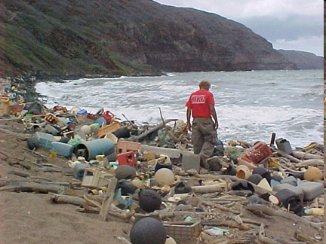
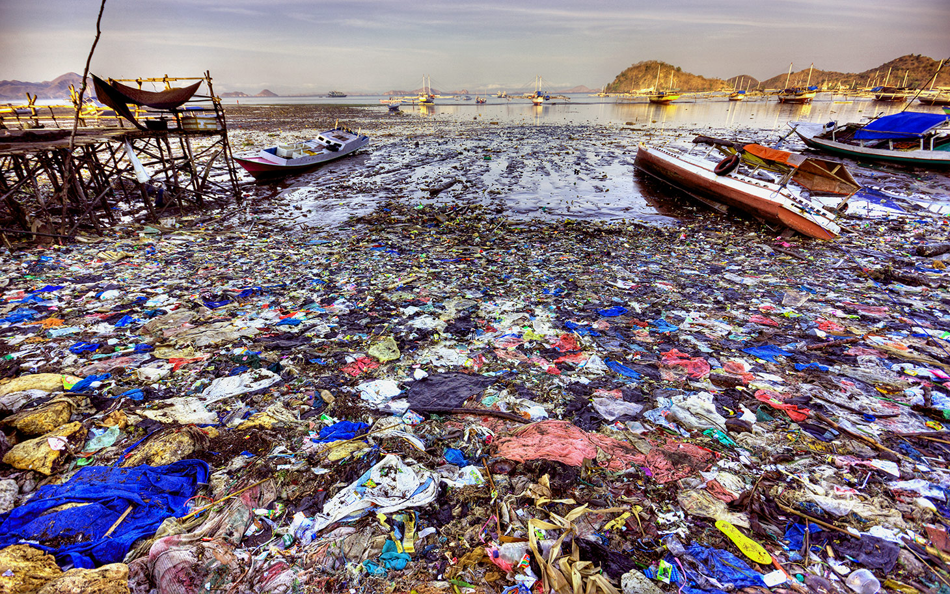
1. Internet and social media
Power of the internet to connect people to causes they care about and to raise awareness on critical issues.

Slide 3
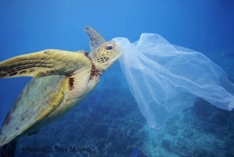
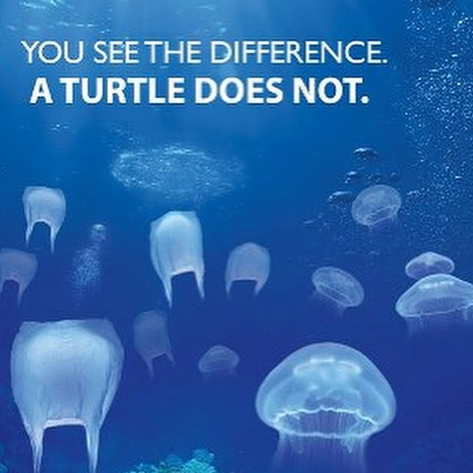
2. Satellite observation of ocean plastics
Using satellite imaging and machine learning to help clean up and capture the 5 trillion pieces of plastic trash they have observed in the world’s “ocean garbage patches.” They estimate that within 5 years they could collect 50% of the ocean’s garbage.

Slide 4
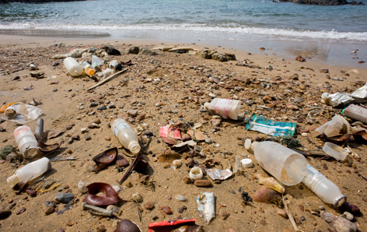
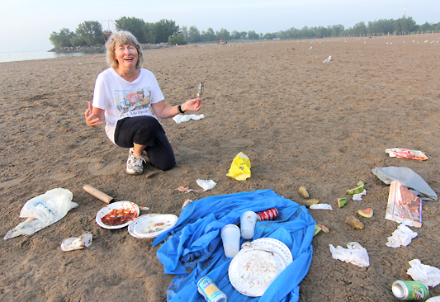
3. Chemical recycling
Mechanical recycling involves sorting, melting and remoulding plastics into lower-grade plastic products. But this process is limited in nature as the performance properties of plastics degrade with every recycle.

Slide 5
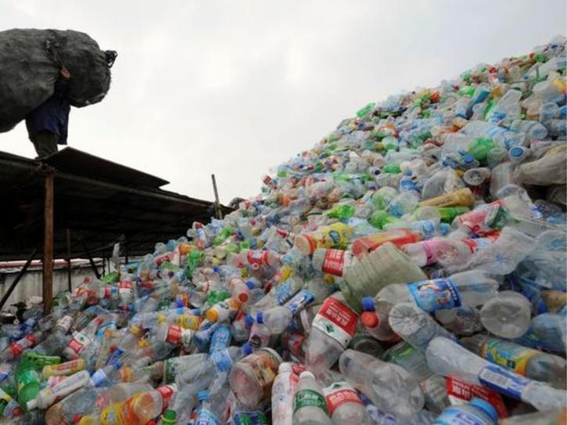
4. Using bio-based biodegradable polymers
Polylactide (PLA) is a biodegradable polymer produced from lactic acid derived from sugar beets, sugar cane and corn. It’s commonly used in packaging industries, textiles, electronics, 3D printing and biomedical applications, thanks to its durability and low toxicity.

Slide 6
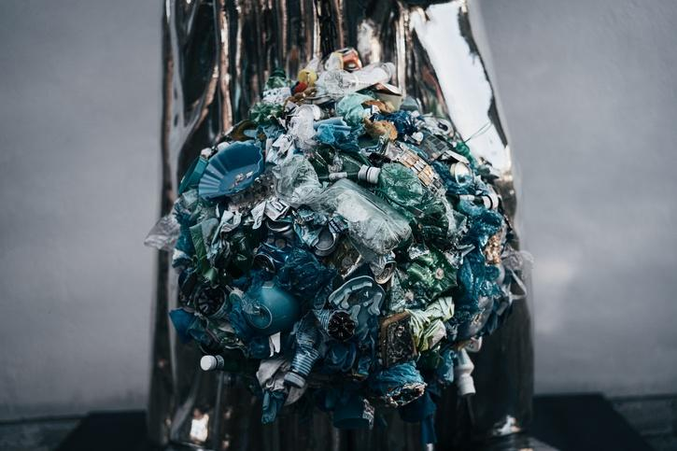
5. Making lightweight aluminium and steel
This high-strength, lightweight aluminum alloys with strength comparable to stainless steels would revolutionize the automobile and aerospace industries. Unlike plastics, they can also be easily reused and recycled into aluminium bottles and cups as well as metal foils for packaging and wrapping purposes.

